Slide 1

Niubility
Plan for your life
Group member:
Ming Zhao
Baosheng Zheng
Daily Tasks Administration System

Slide 2



Story - Background: Setting the characters
Students
Instructors
Workers

Slide 3
Motivation of the Niub
Background:
We sometimes miss homework deadlines and sometimes forget small, unimportant things.
While we can put important things in our phone memos to remind us of them once a day, if they become too many, we tend to put them aside and lose enthusiasm for completing them.
In order to have enough space for all of our lives, we designed this software to plan and record our lives.
Users can write about their plans or record their own stories.
App that grows with users are what we designed this site for.

Slide 4
Story
Problem:
You may forget to do something because your daily tasks are not organized in an orderly manner.
You have a deadline at 5 pm, but you thought the due at 11:59pm, then you will miss the deadline.
You have a lot of work today but don't know where to start.

Slide 5

Design Concept
Provide users with a convenient task management system, which can efficiently list daily tasks and task priorities. Can help users save time and easy to operate.

Slide 6
Demo time

Slide 7
Self-analysis
A simple application.
Since there are too many applications with different features, we go back to the original function of application for planning, for recording, which make customers more convenient and more focused on one thing.

Slide 8
Plan for finalization
Adding more features:
Add a detail page for each task. When user click the task, the browser can open a new window and present the description of the task.

Slide 9



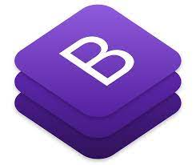

What is our tech stack

Slide 10

Questions
Language: Python, JavaScript
Framework: Flask
Web design: HTML and CSS
Database: MySQL

Slide 11
Thank you for watching

